Slide 1
2023 NASTTPO
Salt Lake City, UT
Organization
Date

Slide 2

Agenda
Why Chemical Facility Security?
Chemical Facility Anti-Terrorism Standards (CFATS)
ChemLock
Ammonium Nitrate Security Program (ANSP)

Slide 3
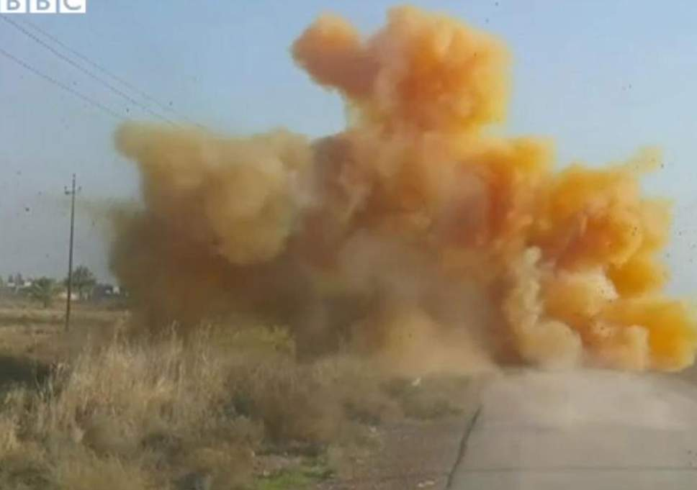


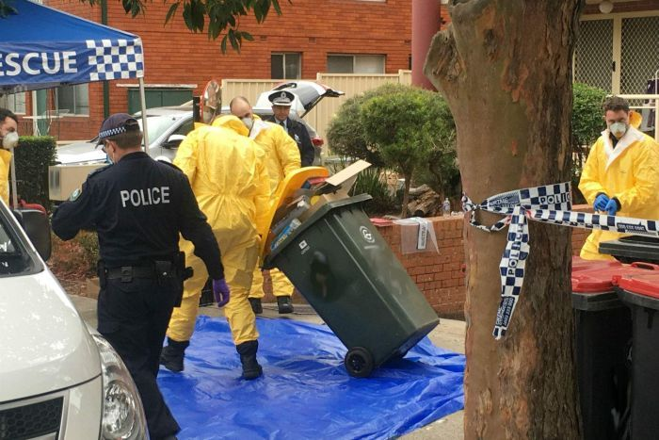
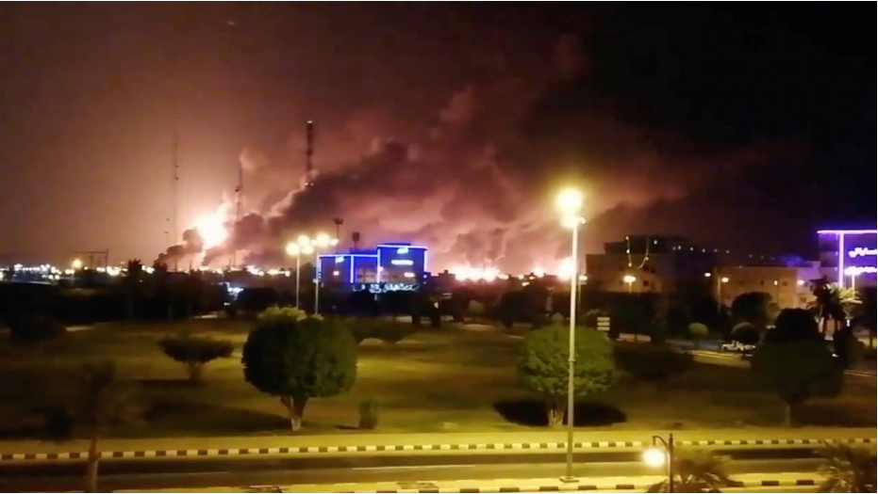
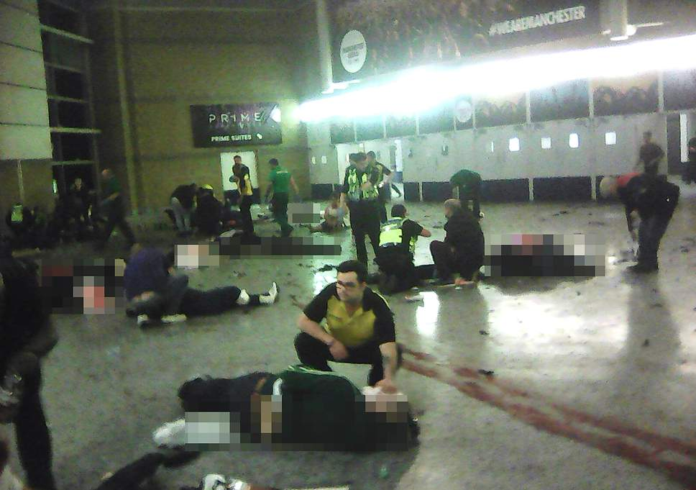

Why Chemical Facility Security?
  We face a persistent and evolving threat
  A successful attack on a chemical facility could potentially cause a significant number of deaths and injuries
  Certain chemical facilities possess materials that could be stolen or diverted and used for terrorist activities
Variety of Threats
Modern-Day Tactics
Toxic industrial chemicals, such as chlorine
Production of chemical weapons
Chemicals used in improvised explosive devices
Chlorine Gas Bomb, Iraq, 2015
French Authorities Hold Suspect in Beheading and Explosion at Chemical Plant
NY Times, June 26, 2015
Hydrogen Sulfide, Australia, 2017 (foiled)
Drones Strike World’s Largest Oil Processing Facility in Saudi Arabia
AP, Sept 14, 2019
Manchester Arena, England, 2017

Slide 4















Industries with Dangerous Chemicals
Colleges and Universities
Cold Chain/ Refrigeration
Fisheries and Hatcheries
Energy Utilities
Agricultural Production
Industrial Manufacturing
Paints and Coatings
Plastics Manufacturing
Laboratories
Mining
Pulp and Paper
Semiconductor Manufacturing
Motor Racing
Warehouses/ Distribution
Water Treatment

Slide 5



CISA Programs to Secure Chemicals
Chemical Facility Anti-Terrorism Standards (CFATS) Regulation
Facilities must report chemicals of interest (COI)
High-risk facilities create tailored chemical security plans that meet CISA’s cyber and physical security standards
Program is set to expire on July 27, 2023; CISA supports long-term (5+ years) reauthorization
Proposed Ammonium Nitrate (AN) Security Regulation
Point-of-sale reporting of AN purchases
Final rule has not been promulgated
Regulatory
ChemLock
Voluntary tools and services to facilitate facility security
Open to all facilities with dangerous chemicals
International
Global Congress on Chemical Security and Emerging Threats
International Testing project
Bomb-Making Materials Awareness Program (BMAP)
Voluntary
Outreach, training, and awareness
Chemical Facility Security Initiatives
Point-of-Sale Explosive Precursor Initiatives

Slide 6
Chemical Facility Anti-Terrorism Standards (CFATS)

Slide 7
The CFATS Regulation
Regulation based on chemical holdings, not industry type
322 chemicals of interest (COI) trigger reporting requirements
  Exemptions
CISA’s risk-based tiering methodology identifies which facilities are high-risk
  Around 3,300 high-risk facilities
High-risk facilities develop and implement tailored security plans
  Risk-Based Performance Standards (RBPS) – cyber and physical security
Inspections ensure security is adequate and in place
Enforcement
Security concerns for which facilities are considered high-risk

Slide 8
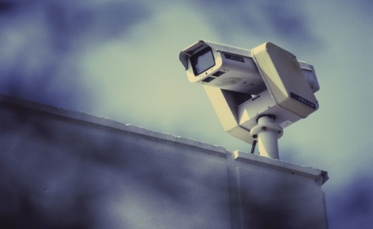
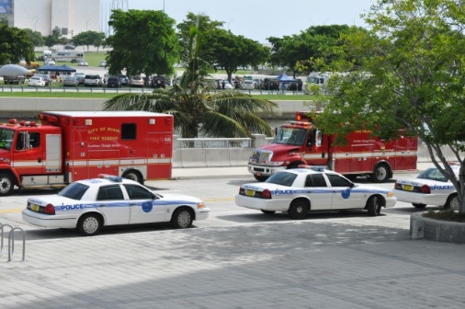


CFATS Overarching Security Objectives
CISA has grouped facility security into five overarching security objectives to help facilities develop tailored security plans that meet risk-based standards
Detection
Delay
Response
Cybersecurity
Security Management

Slide 9

RBPS 9 – Response
Develop and exercise an emergency plan to respond to security incidents internally and with assistance of local first responders.
Response focuses on the planning to mitigate, respond to, and report incidents in a timely manner between facility personnel, first responders, and law enforcement
Local Emergency Planning Committees (LEPCs) may be contacted by local Chemical Security Inspectors (CSIs) to verify that facilities have developed plans for emergency notification, response, evacuation, etc.
CISA Gateway (EO Portal) – A CISA platform to share and coordinate CFATS information among federal, state, local, tribal, and territorial (SLTT) agencies partners.

Slide 10
Security Components and Activities
What are some possible facility security components related to RBPS 9 – Response?
Crisis Management Plan
Communication systems
Process safeguards
Outreach
What are some activities a facility may want to include in its Crisis Management Plan?
Contingency plans
Continuity of operations
Emergency response
Post-incident security
Evacuation
Notification control
Re-entry
Security response

Slide 11
Reporting Significant Security Incidents
What Is Significant?
Contact First Responders
Breach of perimeter or asset
Inventory issue
Suspicious order
Suspicious person, vehicle, or UAS
Broken equipment
Missing shipment/order
Cyber intrusion, phishing, or ransomware
If a significant security incident or suspicious activity is detected while in progress.
If a significant security incident or suspicious activity has concluded, but an immediate response is necessary.
Once a security incident or suspicious activity has concluded and any resulting emergency has been dealt with.
Reporting an Incident to CISA
Once an incident has concluded and any emergency has been addressed, report significant cyber and physical incidents to CISA Central at central@cisa.gov.
CISA Central provides a critical infrastructure 24/7 watch and warning function and gives all critical infrastructure owners and operators a means to connect with and receive information from all CISA services.
Learn more at cisa.gov/central or at cisa.gov/cfats-cyber-reporting.

Slide 12
The Role of First Responders
Collaboration between CFATS covered facilities and first responders is critical to ensuring a secure and resilient community.
Compliance with the RBPS is beneficial to the facility and the emergency response community, for example:
  Detect, Deter, and Delay (RBPS 4)
  Response (RBPS 9)
  Training (RBPS 11)
  Reporting of significant security incidents (RBPS 15 and 16)
Facilities are encouraged to coordinate with the emergency response community as they develop these aspects of their SSPs/ASPs.
The first time local emergency responders visit a facility should not be at the time of an incident.

Slide 13
CFATS and the CISA Gateway
Through the CISA Gateway, CFATS data is available in a For Official Use Only (FOUO) layer and a Chemical-terrorism Vulnerability Information (CVI) layer to authorized federal, SLTT, and first responders with an established “need-to-know” as determined by CISA.
FOUO access allows users to view information on a chemical facility (such as name, location, and geospatial information) within their state, county, and surrounding counties, whereas CVI access includes additional information, such as CFATS tiers.
How do I gain access to CFATS information on the CISA Gateway?
Visit cisa.gov/cfats-eo13650 for more information and to request access.

Slide 14
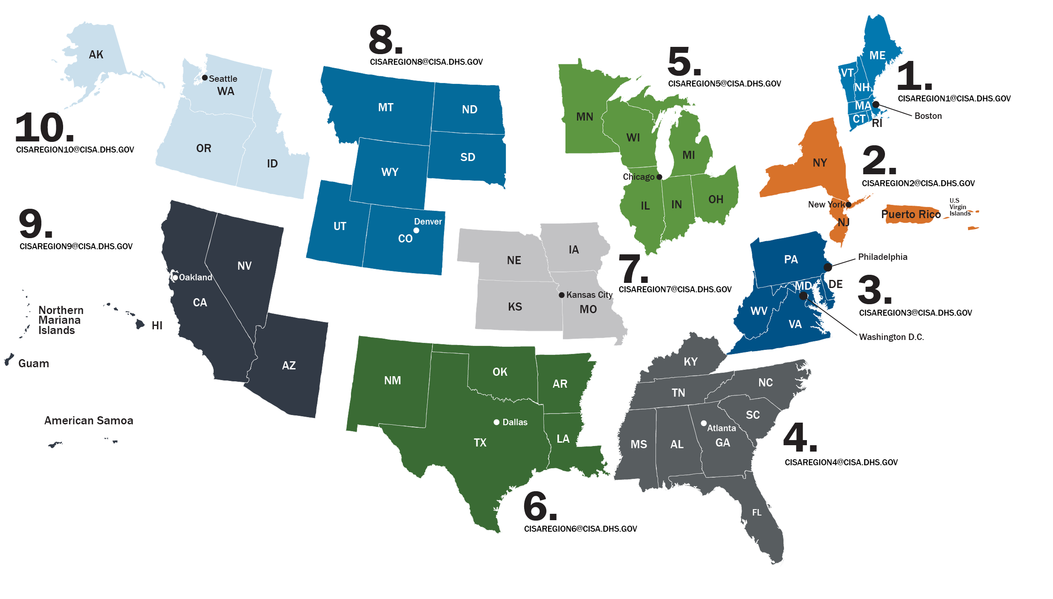
Chemical Security Inspectors
Chemical Security Inspectors in all 50 states
  More than 150 CSIs
  Organized into teams in each of the 10 federal regions
CSIs conduct:
  Authorization Inspections
  Compliance Assistant Visits
  Compliance Inspections
  Stakeholder outreach
CSIs also attend meetings with federal, state, local, and private industry members

Slide 15
ChemLock

Slide 16

Know your chemicals.
Lock in your security posture.

Slide 17





ChemLock Services and Tools
Security awareness consultations
Security posture assessment
Actionable security planning
Security planning guidance
Security planning template
Fact sheets and best practices
Chemical security exercise templates
CISA-facilitated tabletop exercises
Introduction to Chemical Security
Secure Your Chemicals Security Planning
CISA Active Shooter Preparedness
Cyber Security Evaluation Tool (CSET) Demo
All ChemLock services are completely voluntary and no cost.

Slide 18
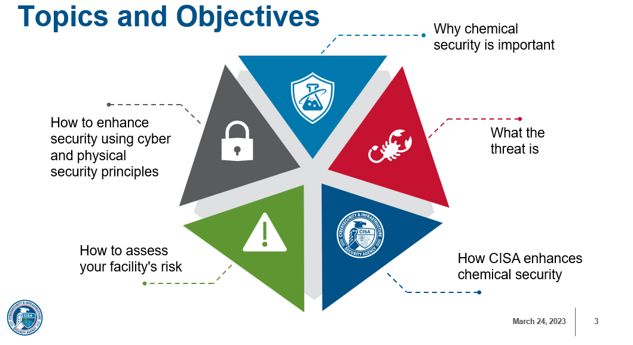

Upcoming ChemLock Training Dates
ChemLock: Introduction to Chemical Security
  July 13, 2023 – 1-3 pm ET
  October 17, 2023 – 10 am-Noon ET
ChemLock: Secure Your Chemicals Security Planning
  May 11, 2023 – Noon-3 pm ET
  August 10, 2023 – 1-4 pm ET
  November 14, 2023 – 10 am-1 pm ET
cisa.gov/chemlock-training

Slide 19
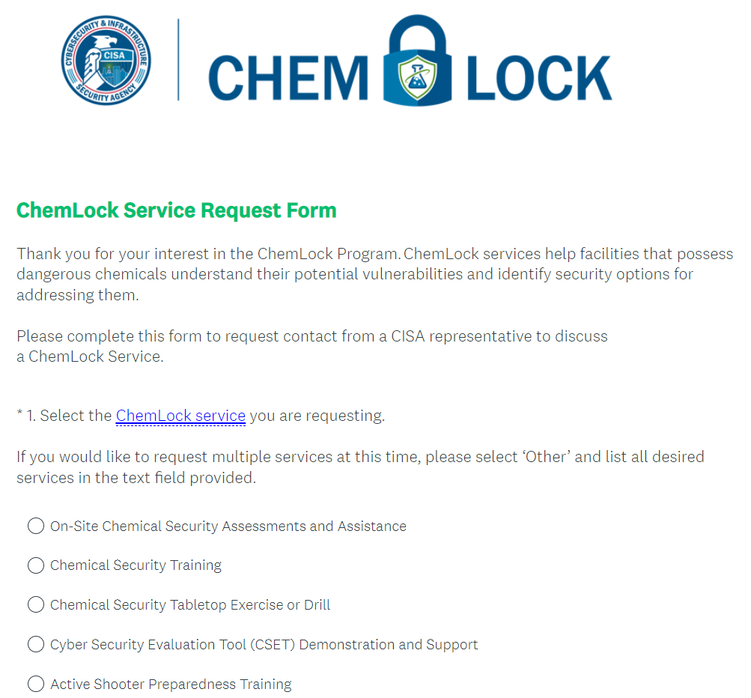


How To Sign Up for a ChemLock Service?
Visit cisa.gov/chemlock
Fill out our short service request form
CISA will contact you to follow up about the service you are requesting
Questions about ChemLock?
ChemLock@cisa.dhs.gov
cisa.gov/chemlock
Example ChemLock Service Request Form

Slide 20





ChemLock@cisa.dhs.gov
CFATS@hq.dhs.gov
cisa.gov/chemlock
cisa.gov/cfats

Slide 21
Ammonium Nitrate Security Program

Slide 22
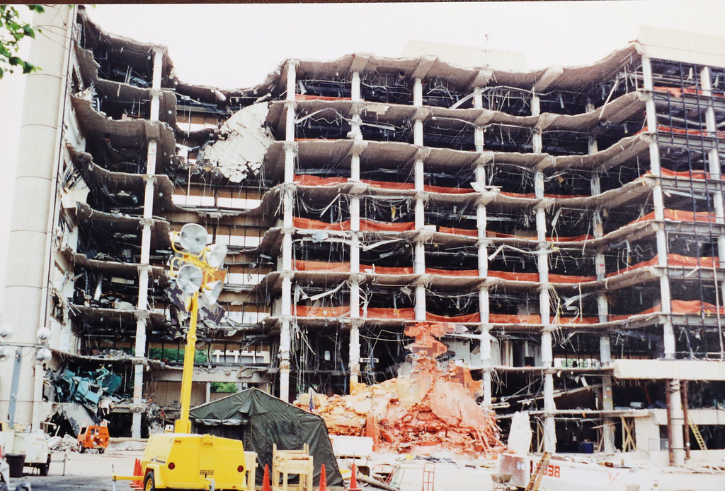
Ammonium Nitrate Security Program (ANSP)
Congress authorized DHS to “regulate the sale and transfer of ammonium nitrate (AN)... to prevent the misappropriation or use of AN in an act of terrorism.” (Pub. L. 110-161)
Requirements include:
  Register AN sellers and purchasers and vet them against the Terrorist Screening Database
  AN sellers must create and maintain records on AN sales or transfers for two years
  AN facilities must report theft or loss of AN
DHS has not yet issued regulations implementing this authority
  Still searching for an approach that balances cost and security value given the single precursor focus
In addition to its many legitimate uses, ammonium nitrate was the primary explosive used in the deadly Oklahoma City bombing in April 1995. (Creative Commons)

Slide 23
Update: Supplemental Notice of Proposed Rulemaking (SNPRM)
2011: DHS issued a Notice of Proposed Rulemaking (NPRM) (76 FR 46907).
2022: DHS working on a Supplemental Notice of Proposed Rulemaking (SNPRM)
2022: DHS held required consultations with industry and state government stakeholders
  Statute requires CISA to carry out consultations with three types of stakeholders to “ensure that the access of agricultural producers to ammonium nitrate is not unduly burdened” and to review the appeals process.

Slide 24




Ammonium Nitrate Consultations
Statute (6 U.S.C. 488a(g) and 6 U.S.C. 488a(i)(4)(B)):
  "[DHS] shall consult with the Secretary of Agriculture, States, and appropriate private sector entities, to ensure that access of agricultural producers to ammonium nitrate is not unduly burdened.”
  “[DHS], in developing the appeals process [for denied AN registration numbers], shall consult with appropriate stakeholders.
Purpose of the consultations:
  Learn from stakeholders how proposed changes in the SNPRM will affect them.
  Learn from stakeholders how they view the burden of the SNPRM.
The consultations do not replace the normal public notice and comment period for this rulemaking.

Slide 25
Resources

Slide 26
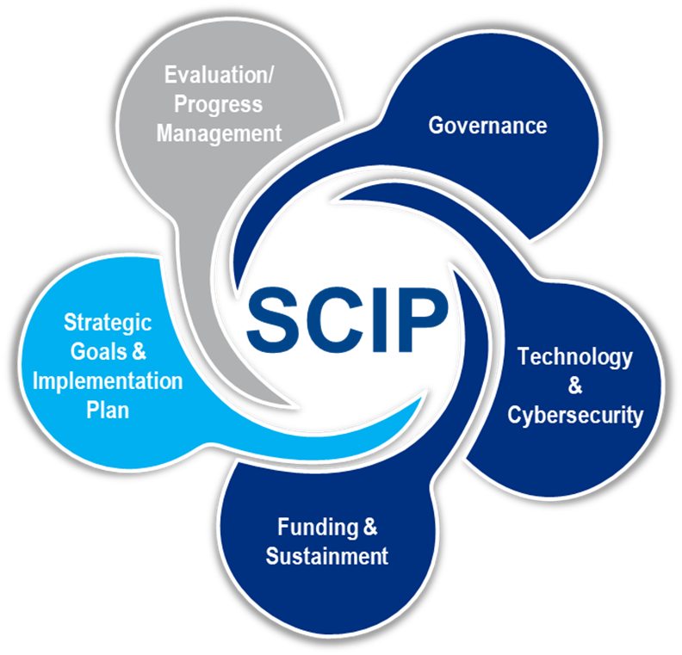
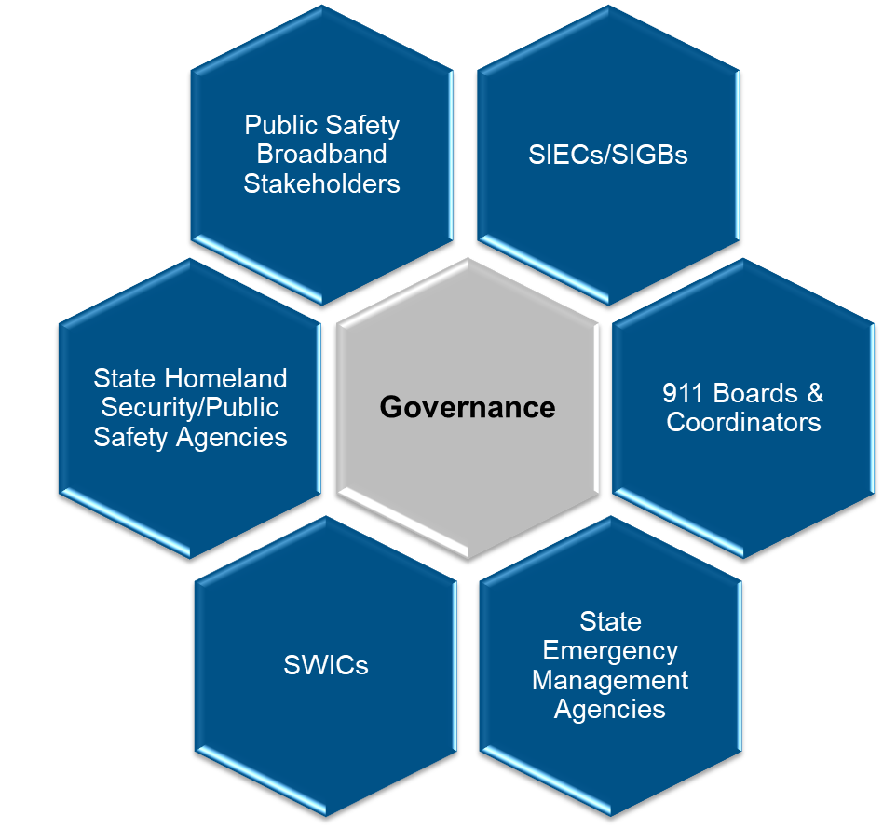
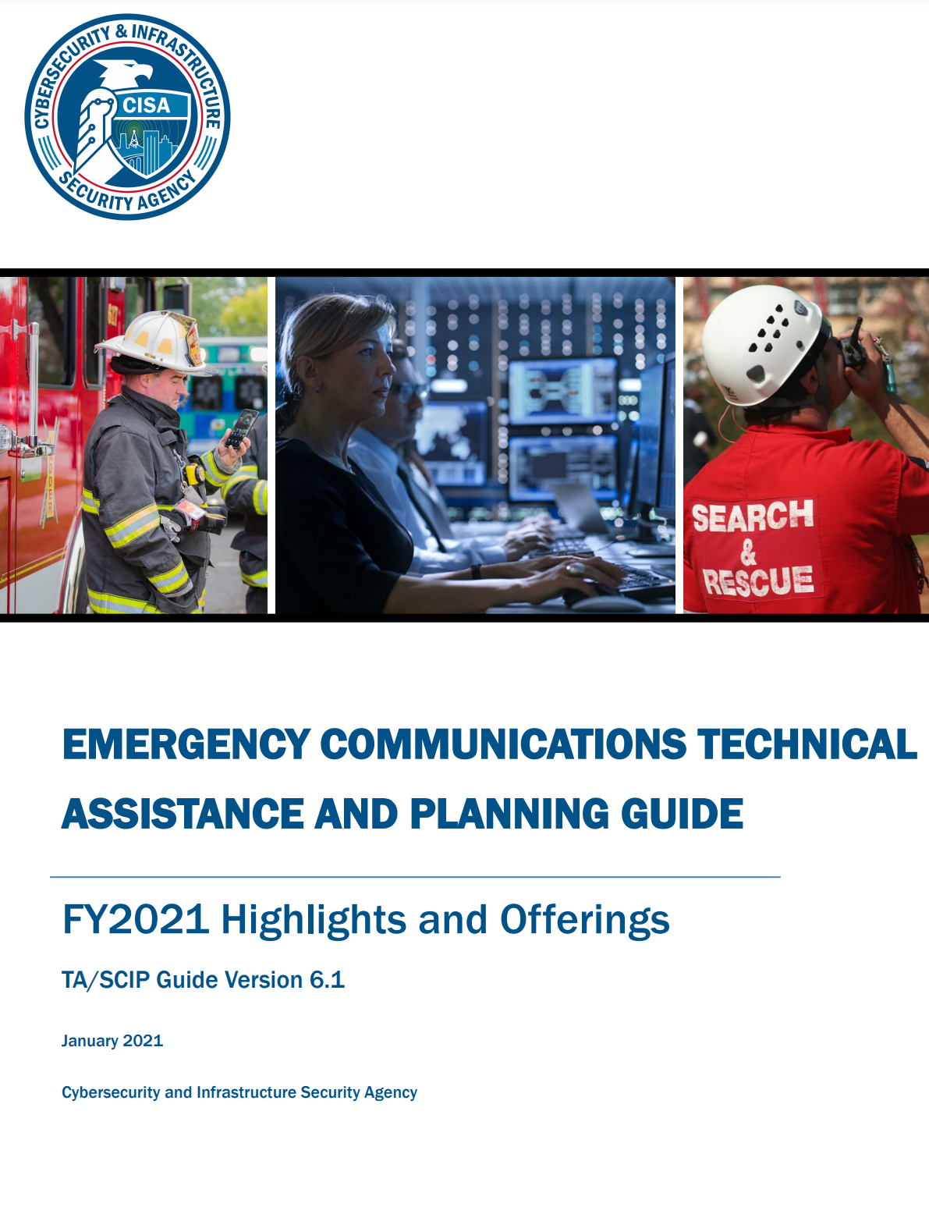
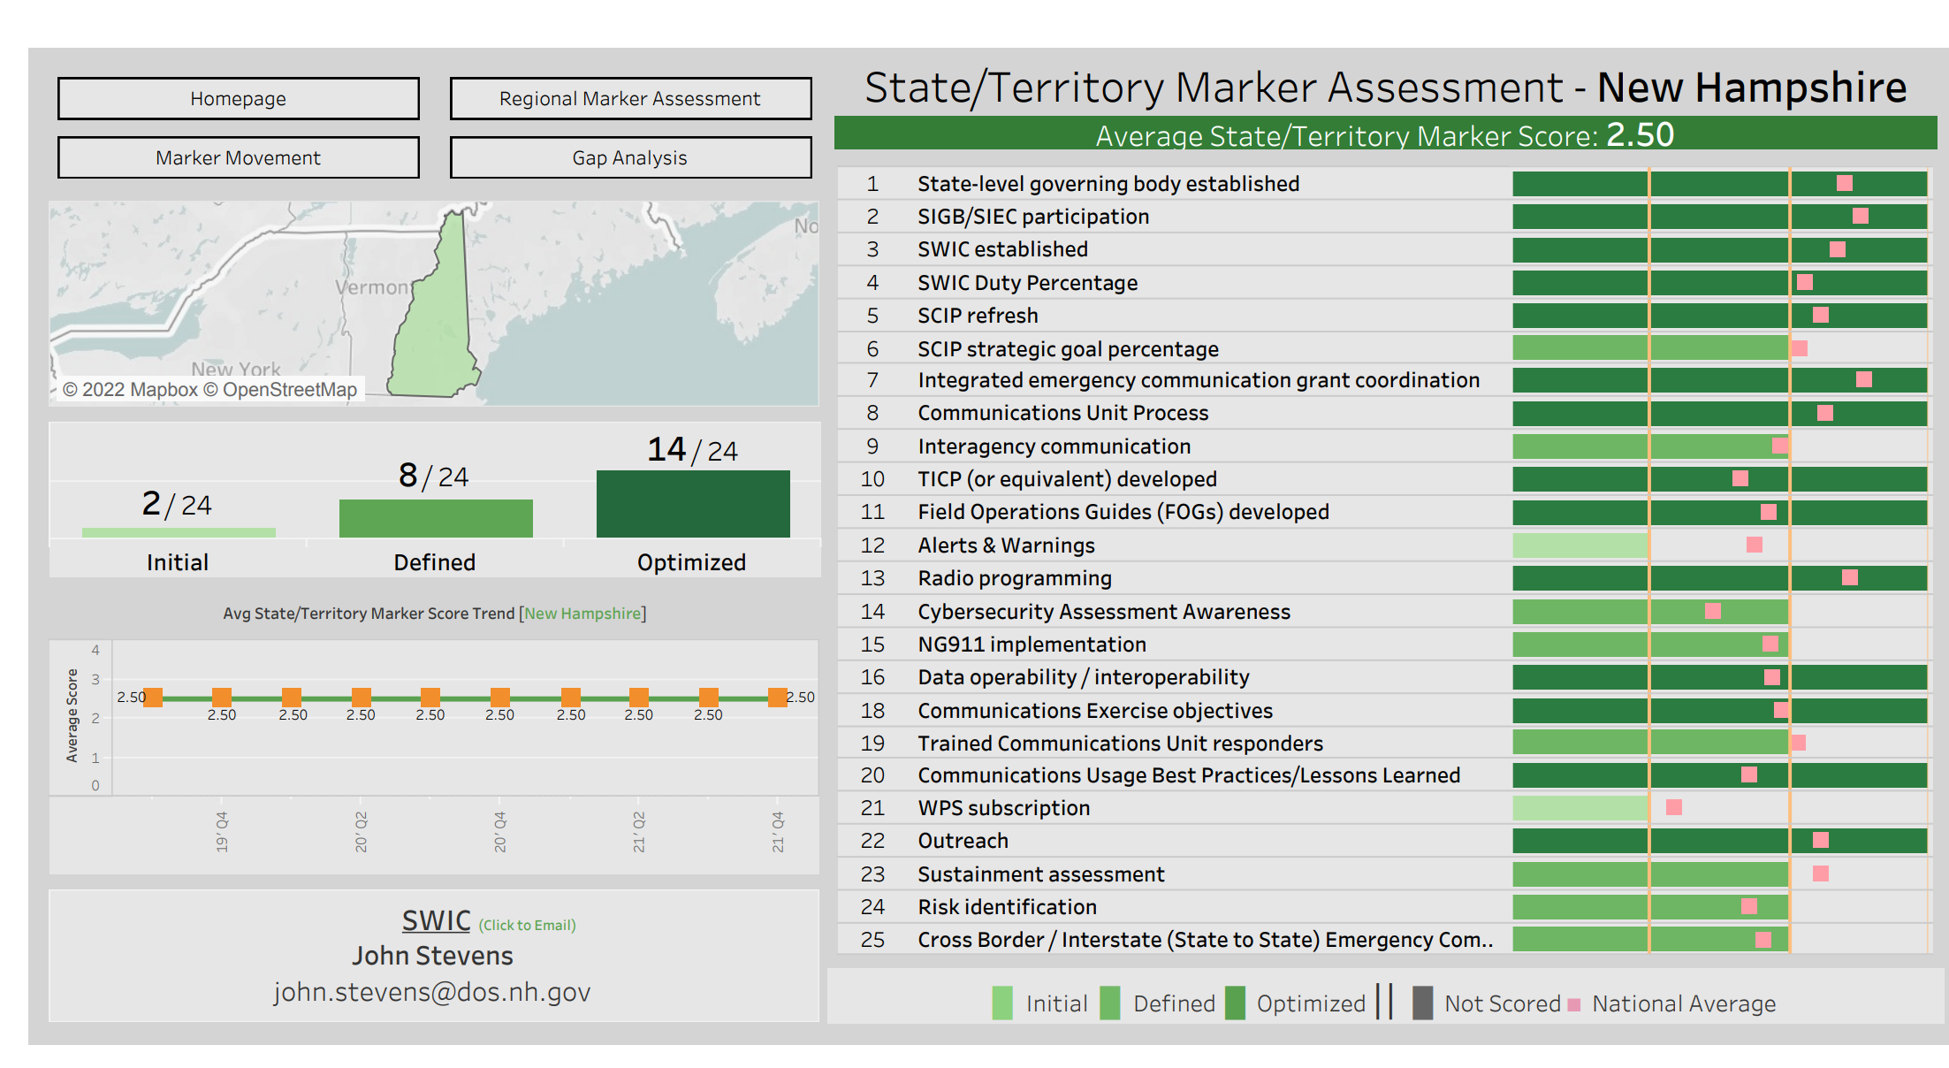

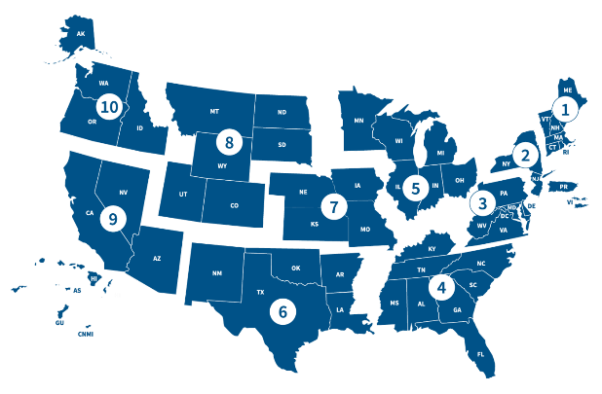



Emergency Communications Coordinators (ECCs)
Strategic Planning
Governance
Technical Assistance
Assessment
State & Tribal Communications Interoperability Plans
Service Offerings Guides
State Markers
Regional Coordination
STATEWIDE INTEROPERABILITY COORDINATOR (SWIC)
ECCs support emergency communications
across government and critical infrastructure
ECCs maintain close relationships with
SWICs and public safety in their regions
Special Coordination
ESF-2 | NSSE | SEAR
6,000+
Public Safety Answering Points (911)
50,000+
Radio Systems
300,000+
Cell Towers & Radio Sites
Notes:
ECC – Emergency Communications Coordinator
ECCs are subject matter experts (SME) whose mission is to support SLTT in maturing emergency communications and the interoperability of emergency communication technologies.
Nationally there are 3 Supervisory Communications Sector Chiefs and 17 ECCs (total 20FTE).
ECCs promote and support:
Strategic Planning
+ Statewide Communications Interoperability Plans (aka SCIPs – pronounced “skips”)
+ Tactical Interoperability Communications Plans (aka TIC-Ps – pronounced “tick pees”)
Governance
+ Statewide Interoperability Executive Committees (SIECs) (aka Statewide Interoperability Governance Boards or SIGBs)
+ 9-1-1 governance bodies
+ Communications Unit governance bodies
Assistance
+ Technical Assistance – strategic plan development, SOP development, technology assessments, training, exercising, and usage assessments
+ Relationships – partnerships with Statewide Interoperability Coordinators (SWICs), 911 Administrators, Alert & Warning Administrators
Assessments
+ Interoperability Marker – Assist states with self-assess their maturity of 25 standardized interoperability capabilities
Info Current as of April/2023
Stats sourced from ECD

Slide 27

cisa.gov
As the nation’s cyber defense agency, CISA stands ready to help prepare for, respond to, and mitigate cyber attacks.
Notes:
Prior to RU invading UE we issued Shields Up guidance – lower thresholds, defend networks more diligently
The cyber battlefield presents the largest attack surface, and the greatest risk that critical infrastructure owners/operators must manage
This is a new battleground and foreign AND domestic combatants (Russia, China, Iran, others) are incessantly attacking the United States, targeting critical infrastructure to chip away at our national security and economic security.
Our agency is passionate about working with industry to defend the nation in this battle.
CISA’s unique mission is to drive security through truly operational collaboration and partnership
We know that collaboration between the federal government, Infrastructure owners and operators, and cyber network defenders exponentially drive down risk to our nation.
We provide no-cost guidance, services, assessments, training, and more - All to further strengthen our understanding of current and future risks and better meet the diverse needs to secure and defend.
That means operationalizing collaboration, working with our partners to share information in real-time - working together to reduce risk and build resilience from the start to protect the critical infrastructure that Utahns rely on every day.

Slide 28
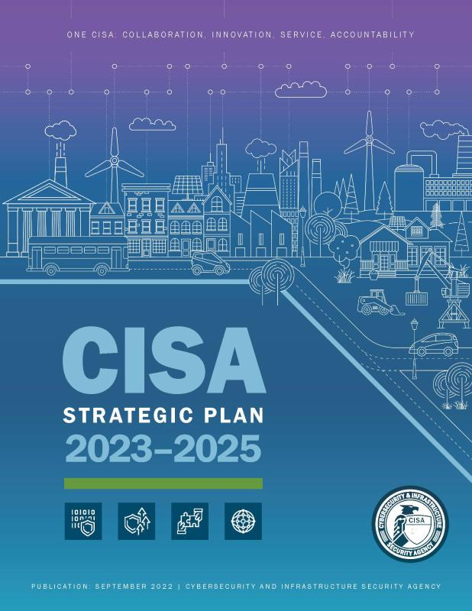
Strategic Goals
Cyber Defense
Risk reduction and resilience
Operational collaboration
Build partnerships
Protect critical infrastructure
Protect people
Protect IT & OT
Build capacity to defend
Notes:
CISA IS A NON-REGULATORY AGENCY – PCII APPLIES TO MUCH OF OUR WORK WHEN NEEDED
WE HAVE A PLAN AND WE CAN’T DO IT WITHOUT YOU

Slide 29




The Complex Threat Environment
Natural hazards
Technological
Manmade
Cyber
Terrorism
Targeted Violence
Supply Chain
Pandemic
Changing Climate
Risk
Threat
Vulnerability
Mitigation
Notes:
Threat landscape – “threatscape”

Slide 30

cisa.gov/cybersecurity
Cyber Resource Hub
Services
Tools
Best practices
Cybersecurity training
cisa.gov/cybersecurity
Notes:
This is the CISA cybersecurity landing page and the one-stop shop for all things cybersecurity
UNDERSTAND THAT ALL CYBERSECURITY WORK IS ABOUT BUILDING RESILIENCE TO EXPLOITATION AND DISRUPTION

Slide 31

Defend Industrial Control Systems
Find and defeat adversaries
Equip owners/operators and cyber defenders
Sustain operational resilience
Assessments
KEVs
Receive advisories
Training and exercise
CISA
Industrial Control Systems
Notes:
This website is the pot of gold – it has all the information you need today to defend and secure industrial control systems

Slide 32
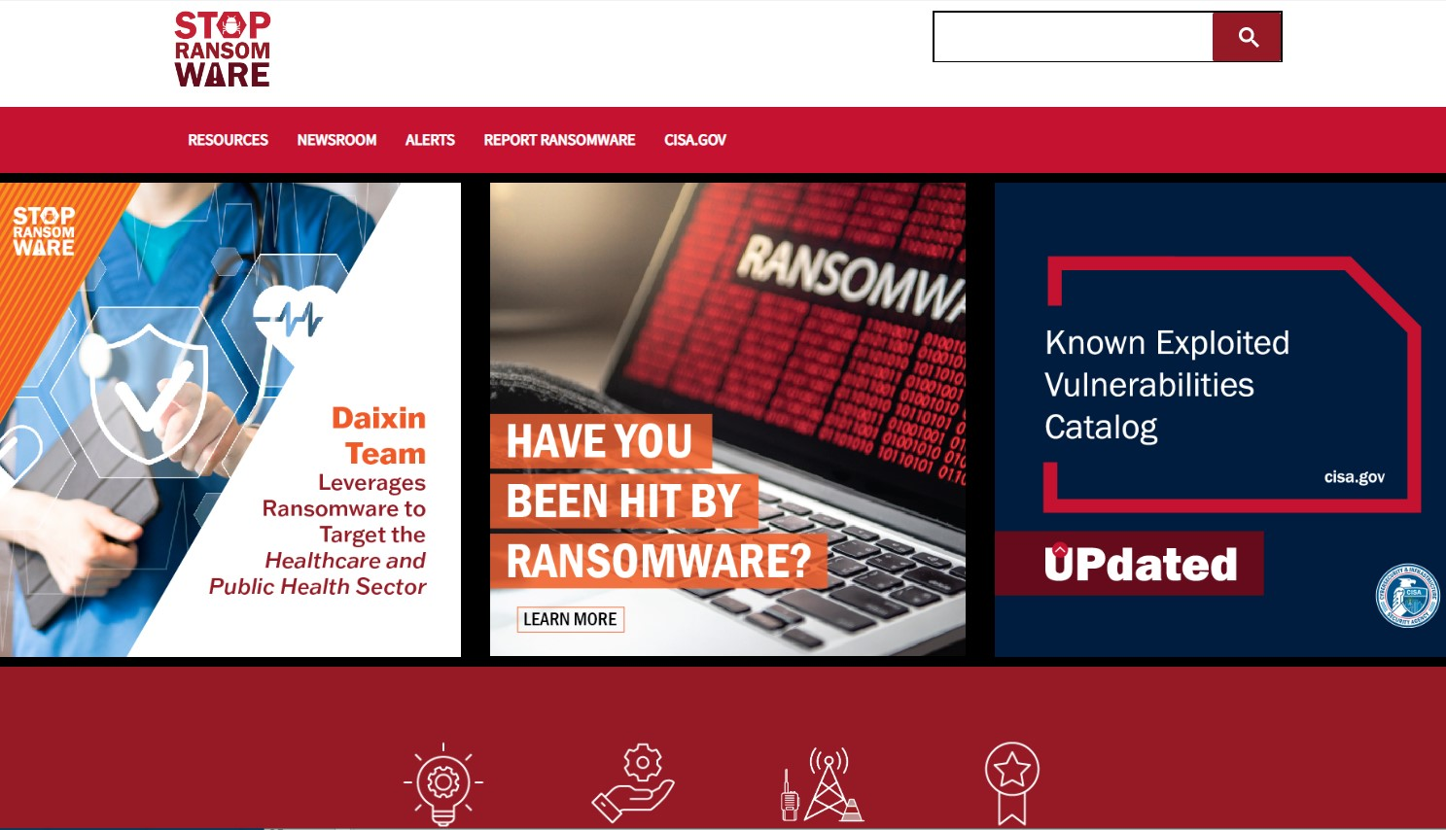
Cybersecurity Basics
stopransomware.gov
Notes:
First and most important tool we have for you to manage this threat.
Stopransomware.gov is our dedicated site all about assisting you with mitigating or managing the ransomware threat. From left of boom to managing an incident. We have a lot of resources to help at stopransomware.gov

Slide 33


CSET Self-Evaluation Tool
Evaluates ICS and IT security practices
Systematic and repeatable
Desktop software
Set to NIST standards
Notes:
Managing risk starts with understanding your current posture
CSET provides that snapshot in time to diagram network topology and identify the criticality of network components
Provides 5 reports
Executive report to more technical for Security Architect/engineer and security staff
You can set CSET to a variety of standards e.g. NERC, FERC, but we recommend NIST as it mirrors the NIST Cybersecurity Framework – our standard
NEXT SLIDE for assisted assessments and CSA support

Slide 34
Cybersecurity Advisor Program
CISA mission: Lead the nations efforts to understand, manage and reduce risk to our critical infrastructure.
In support of that mission: Cybersecurity Advisors (CSAs):
  Assess: Evaluate critical infrastructure cyber risk.
  Promote: Encourage leading practices and risk mitigation strategies.
  Build: Initiate, develop capacity, and support cyber communities-of-interest and working groups.
  Educate: Inform and raise awareness.
  Listen: Collect stakeholder requirements.
  Coordinate: Bring together incident support and lessons learned.
Notes:
As I said, we at CISA have one mission: to lead the collaborative national effort to strengthen the security and resilience of America’s critical infrastructure. We do so by providing direct coordination, outreach, and regional support and assistance to protect cyber components essential to the Nation’s critical infrastructure.
The purpose of CISA’s Cybersecurity Advisor program is to promote and further cybersecurity preparedness, risk mitigation, and incident response capabilities of public and private sector owners and operators of critical infrastructure, and state, local, tribal, and territorial (SLTT) governments, through stakeholder partnerships and direct assistance activities which we undertake with you at no cost to you. All our services, programs, and tools we offer to you are strictly voluntary – you do not have to use any of them – and ALL are free – there is no charge to you whatsoever for any service and tool we offer.
Specifically, to promote the security and resilience of critical infrastructure we:
Undertake risk-based cybersecurity assessments -- such as the Cyber Resilience Review (CRR), Cyber Infrastructure Survey (CIS), and the External Dependency Management (EDM) assessment, which are all free to the critical infrastructure owner and operator, whether SLTT or private sector;
Promote use of best practices such as the NIST Cybersecurity Framework, which is designed as a foundation upon which industry and government can better manage and reduce their cyber risk;
Build and strengthen private-public cybersecurity partnerships through information exchanges, and cyber protective visits;
Educate by raising awareness of various cybersecurity services offered by CISA and other federal and local government programs through cyber resilience workshops, keynotes, panel discussions, and program briefs;
Listen to stakeholder requirements and needs through various working groups, tabletop exercises, and other technical exchanges; and
Coordinate direct assistance and resourcing support conducted in times of cyber threats, disruptions, and attacks.

Slide 35
Range of Cybersecurity Assessments
STRATEGIC
(C-Suite Level)
Cyber Resilience Review (Strategic)
External Dependencies Management (Strategic)
Cyber Infrastructure Survey (Strategic)
Cybersecurity Evaluations Tool (Strategic/Technical)
Phishing Campaign Assessment (Technical)
Vulnerability Scanning / Hygiene (Technical)
Validated Architecture Design Review (Technical)
Risk and Vulnerability Assessment (Technical)
TECHNICAL
(Network-Administrator Level)
Notes:
We have a broad range of assessments. All assessments provide a report for options for consideration to assist with better configuring devices and improving security and resilience posture.
Some are best undertaken with technical folks, others with executives.
All assessments are no- cost and all are voluntary.
RECOMMEND STARTING W/ STRATEGIC ASSESSMENTS AND PROGRESS TO MORE TECHNICAL ASSESSMENTS
RECOMMEND START W/ CRR – This provides your baseline posture– 5 hours long
ENSUING ASSESSMENTS. NEXT you want to assure cybersecurity controls are extended to the supply chain to further harden and secure
The EDM assists to understand external dependencies e.g., vendors, network components, software
NEXT use the CIS which provides an interactive dashboard to build scenarios that show the Return on Investment for adding security controls (they cost, right?!) – a very valuable assessment tool for justifying investments in security
ALL ASSESSMENTS come back with report for OFCs to assist you to better configure your devices and improve your security and resilience posture
Provide recommendations on priorities and investment that result in maturity improvements
A phishing assessment is a good next step to help validate your posture
MB DO NOT emphasize VADR, RVA (reserved for more mature stakeholders and limited bandwidth)

Slide 36

Subscribe to ICS Advisories
Alerts
Bulletins
Current activity
Analysis reports
Subscribe to NCAS Alerts
Report
Contact for help
Search for more resources
cisa.gov
cybersecurity advisories
Notes:
More topics found at CISA.gov/cybersecurity
This QR is specifically for the ICS advisory website
Also subscribe to the NCAS for alerts, bulletins, links to cybersecurity tips and reports
and a tab linking you to best practice resources such as the NIST Cybersecurity Framework, guidance for small and mid-sized businesses, assessments and a lot more

Slide 37

Incident Reporting / Malware Analysis
Report incidents
Share indicators
Report phishing & malware
Report vulnerabilities
Anonymized
Assists others
Report to CISA
888-282-0870
Notes:
This is the site for reporting
Software or ICS vulnerabilities, indicators or incidents
This is a whole-of-industry effort to thwart malicious activity and to assist others which makes the entire cyber landscape more secure and resilient

Slide 38
Cybersecurity Advisor Program
Cybersecurity Advisors (CSA) help prepare and protect against cybersecurity threats
  Assess: Evaluate critical infrastructure cyber risk
  Promote: Encourage best practices and risk mitigation strategies
  Build: Initiate, develop capacity, and support cyber communities-of-interest and working groups
  Educate: Inform and raise awareness
  Listen: Collect stakeholder requirements
  Coordinate: Bring together incident support and lessons learned
Notes:
Cybersecurity Advisors (CSAs) offer assistance to help prepare against cybersecurity threats
CSAs promote cybersecurity preparedness, risk mitigation, and incident response capabilities, working to engage stakeholders through partnership and direct assistance activities
More Info….
Cybersecurity Advisors Services
Cyber Preparedness: On-site meetings to answer questions, exchange ideas and information, and address concerns about cybersecurity — promoting best practices, resources, and partnership experiences.
Can provide Briefings, presentations much like this one I’m providing, and participate in panel discussions – all delivered to help improve cybersecurity awareness and organizations’ cybersecurity posture
Working Group Support: Workshops to join stakeholders in existing cybersecurity initiatives and groups to enhance information sharing — improving policy, procedures, and best practice, and facilitating lessons-learned.
Partnership Development: Engagements to build and mature local and regional cybersecurity private-public partnerships, and move partnerships from awareness building to operational capabilities.
Incident Coordination and Support: Activities to facilitate cyber incident response and to coordinate information requests in times of increased threat, disruption, and attack.

Slide 39
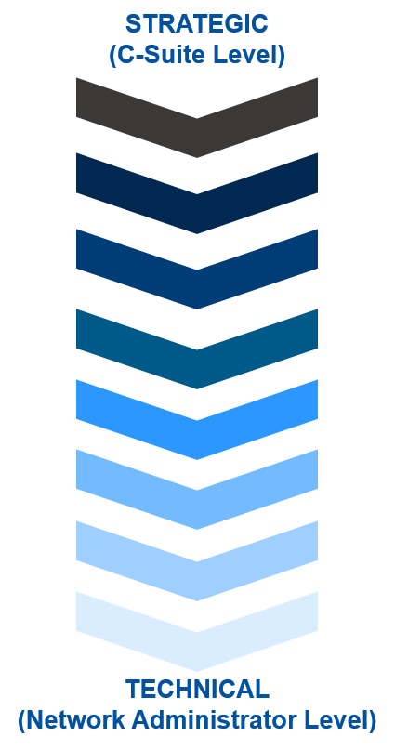
Cybersecurity Assessments
Cyber Resilience Review (Strategic)
External Dependencies Management (Strategic)
Cyber Infrastructure Survey (Strategic)
Cybersecurity Evaluations Tool Strategic (Standards)
Phishing Campaign Assessment (EVERYONE)
Validated Architecture Design Review (Technical)
Vulnerability Scanning / Hygiene (Technical)
Remote Penetration Test (Technical)
Risk and Vulnerability Assessment (Technical)
Notes:
We have a broad range of assessments. Some are best undertaken with technical staff, others with executives. All assessments are no- cost and all are voluntary.
Some you can do yourselves. Some have a queue of up to months. All are extremely useful. CONTACT me if you want to know more. I can provide links.
Cyber Assessments, CSAs conduct the following:
Cyber Resilience Review (CRR): Strategic evaluation that assesses cybersecurity management capabilities and maturity as applied to protect critical information technology (IT) services.
External Dependency Management (EDM): Assessment of the management activities and practices utilized to identify, analyze, and reduce risks arising from third parties.
Cyber Infrastructure Survey (CIS): Survey focused on over 80 cybersecurity controls in five domains, resulting in an interactive decision support resource.

Slide 40
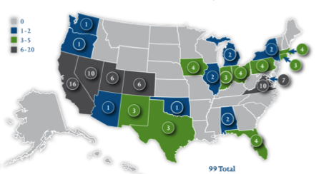
Cyber Exercises and Planning
CISA’s National Cyber Exercise and Planning Program develops, conducts, and evaluates cyber exercises and planning activities for state, local, tribal and territorial governments and public and private sector critical infrastructure organizations.
Cyber Storm Exercise – DHS’s flagship national-level biennial exercise
Unique exercise planning and facilitation
Cyber exercise consulting and subject expertise support
Cyber planning support
Off-the-shelf resources
Notes:
Question for Sean McCloskey: What does this map represent?
Cyber Storm Exercise – DHS’s flagship national-level biennial exercise
Cyber Guard Prelude – annual exercise as precursor to DoD/DHS-led Cyber Guard exercise
End-to-End Cyber Planning and Conduct – leverages FEMA’s Homeland Security Exercises and Evaluations Program (HSEEP) to assist with documentation development, exercise scenario planning, and AAR development
Cyber Exercise Consulting and SME Support
Cyber Planning Support
Off-the-Shelf resources - scenario libraries and play-books, cyber tabletop exercise package, virtual tabletop exercises, planning templates

Slide 41
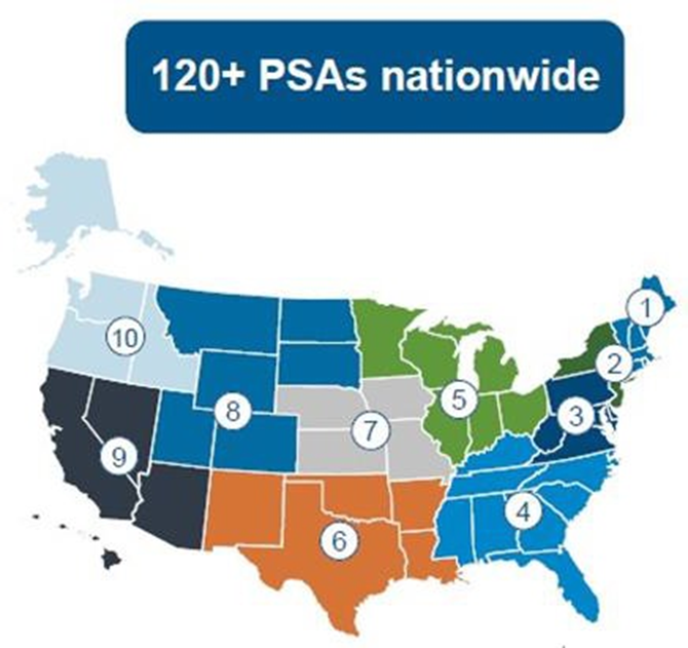
Protective Security Advisors
Advise and assist to understand and protect critical infrastructure
Assessments
Training and exercise
Broker DHS services
Support special event planning
Partner to build capability for security and resilience
Notes:
Managing risk starts with assessing your situation.
Assessments
Training on active assailant – translates beyond the workplace
Advise on security plans and other physical security interests

Slide 42
Utah Cadre
Protective Security Advisor
Matt Beaudry
Jamison Moody
Cybersecurity State Coordinator
Enroute
Cybersecurity Advisor
Rick Gardner
Emergency Communications Coordinator
Gordy Coles
Chemical Security Inspector
Dave Senninger

Slide 43
For more information:
cisa.gov
Questions?
matthew.beaudry@cisa.dhs.gov
801-837-8314

Slide 45
For more information:
cisa.gov/chemical-security
cisa.gov/cfats
cisa.gov/chemlock
For questions:
CFATS@hq.dhs.gov
ChemLock@cisa.dhs.gov

